Slide 1
zekeLabs
Learning made Simpler ! www.zekeLabs.com

Slide 2
Docker History and Introduction

Slide 3
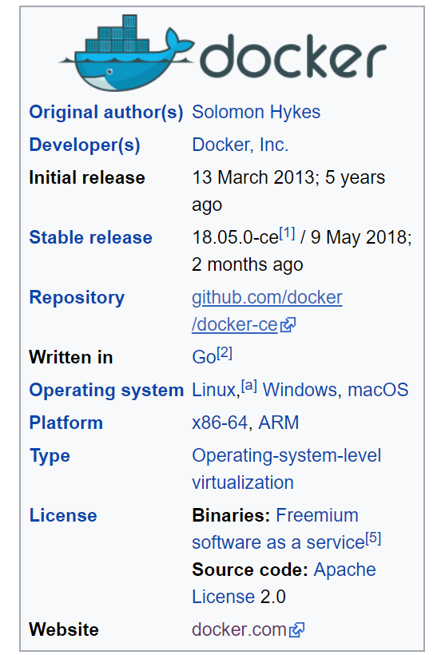
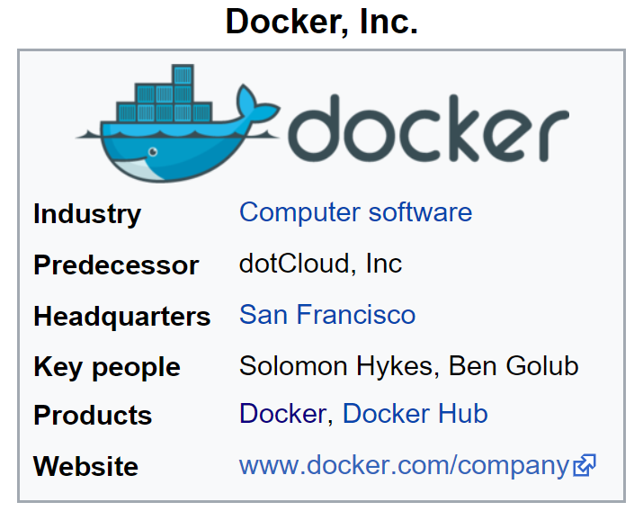
Lets go to Wiki

Slide 4
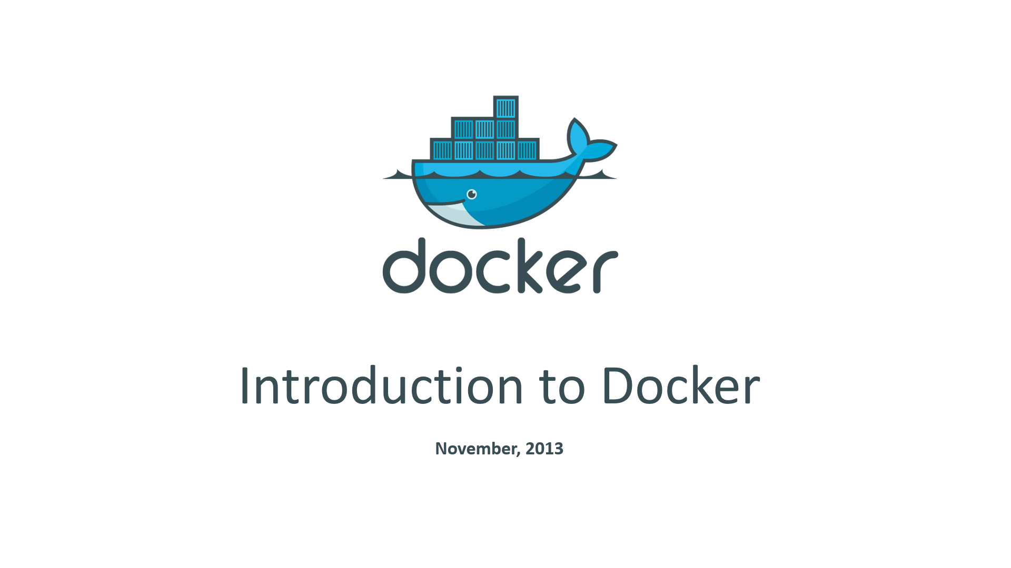
Docker Official Introduction in 2013 … Continued

Slide 5
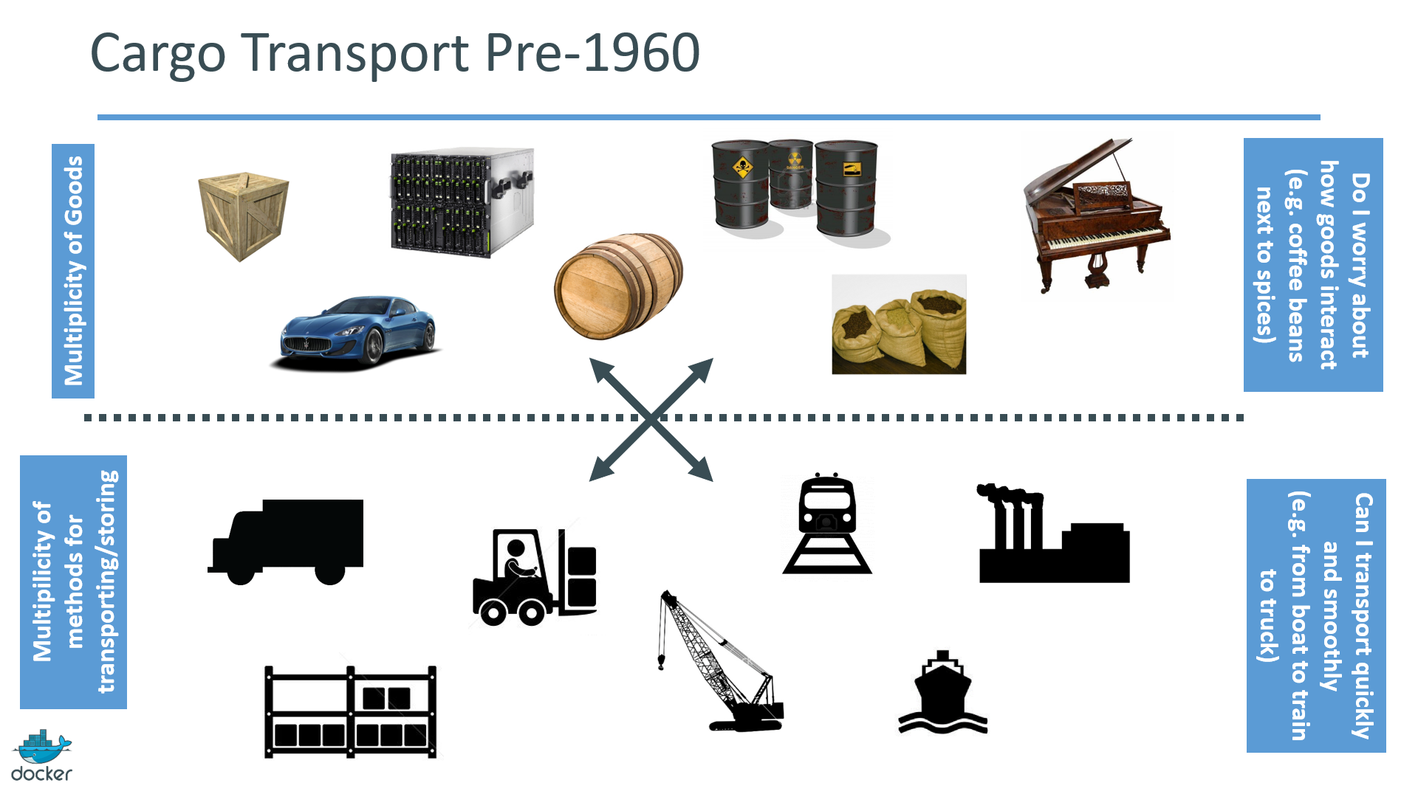
Docker Official Introduction: Nov 2013

Slide 6
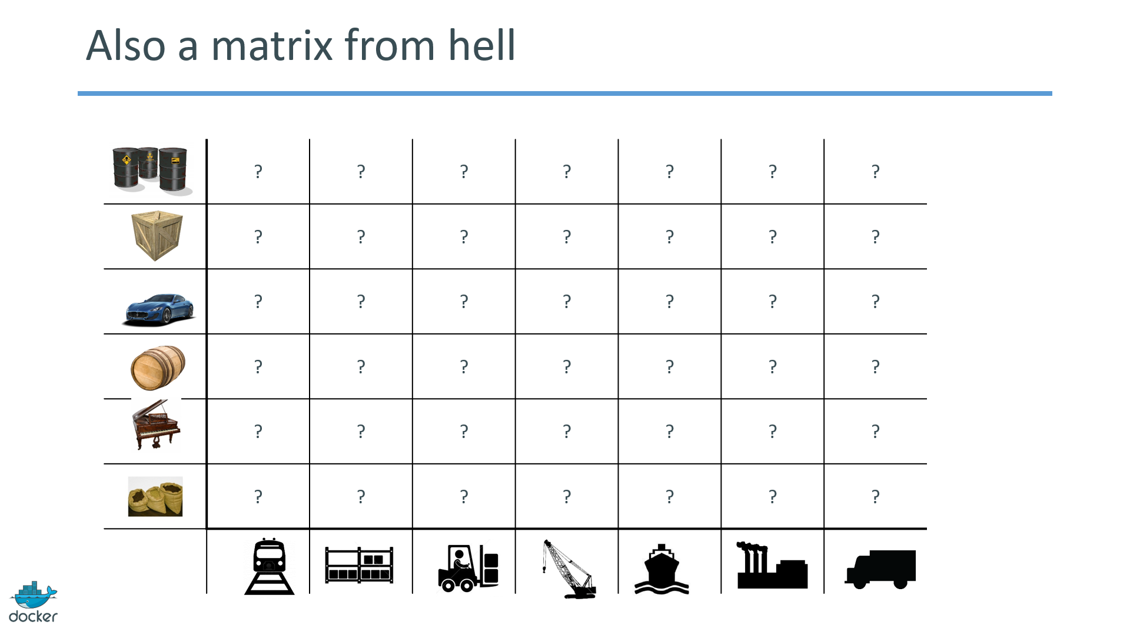
Docker Official Introduction in 2013 … Continued

Slide 7
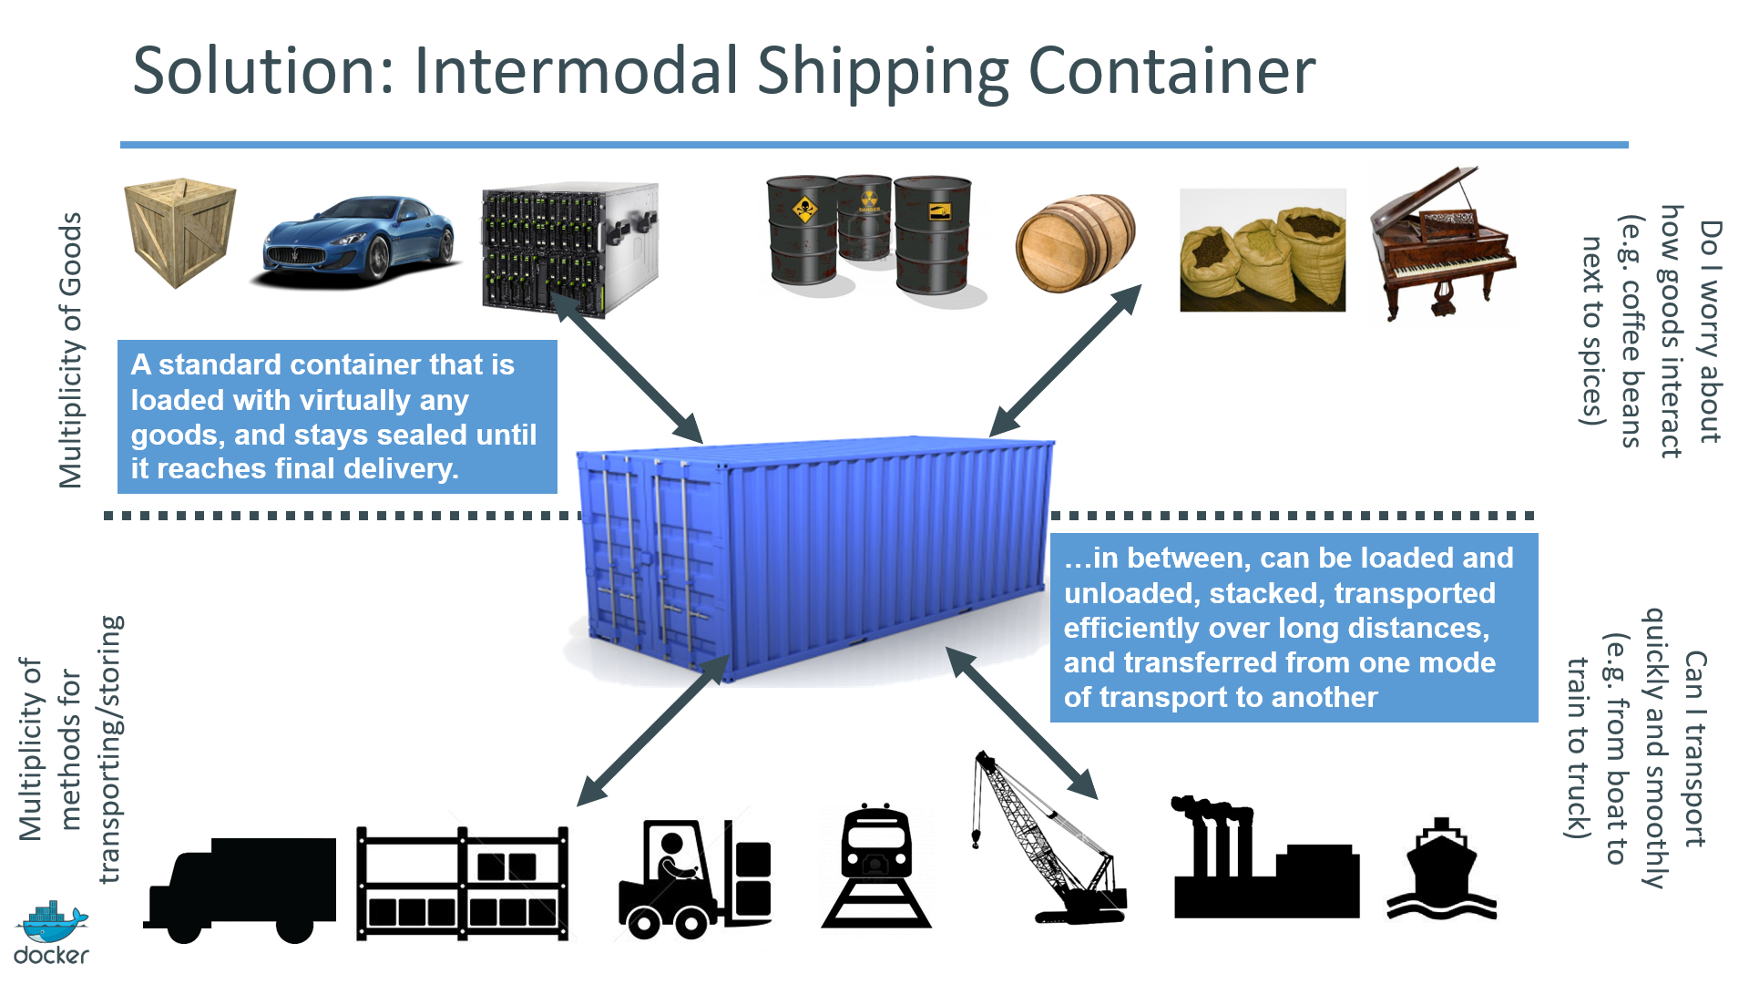
Docker Official Introduction in 2013 … Continued

Slide 8
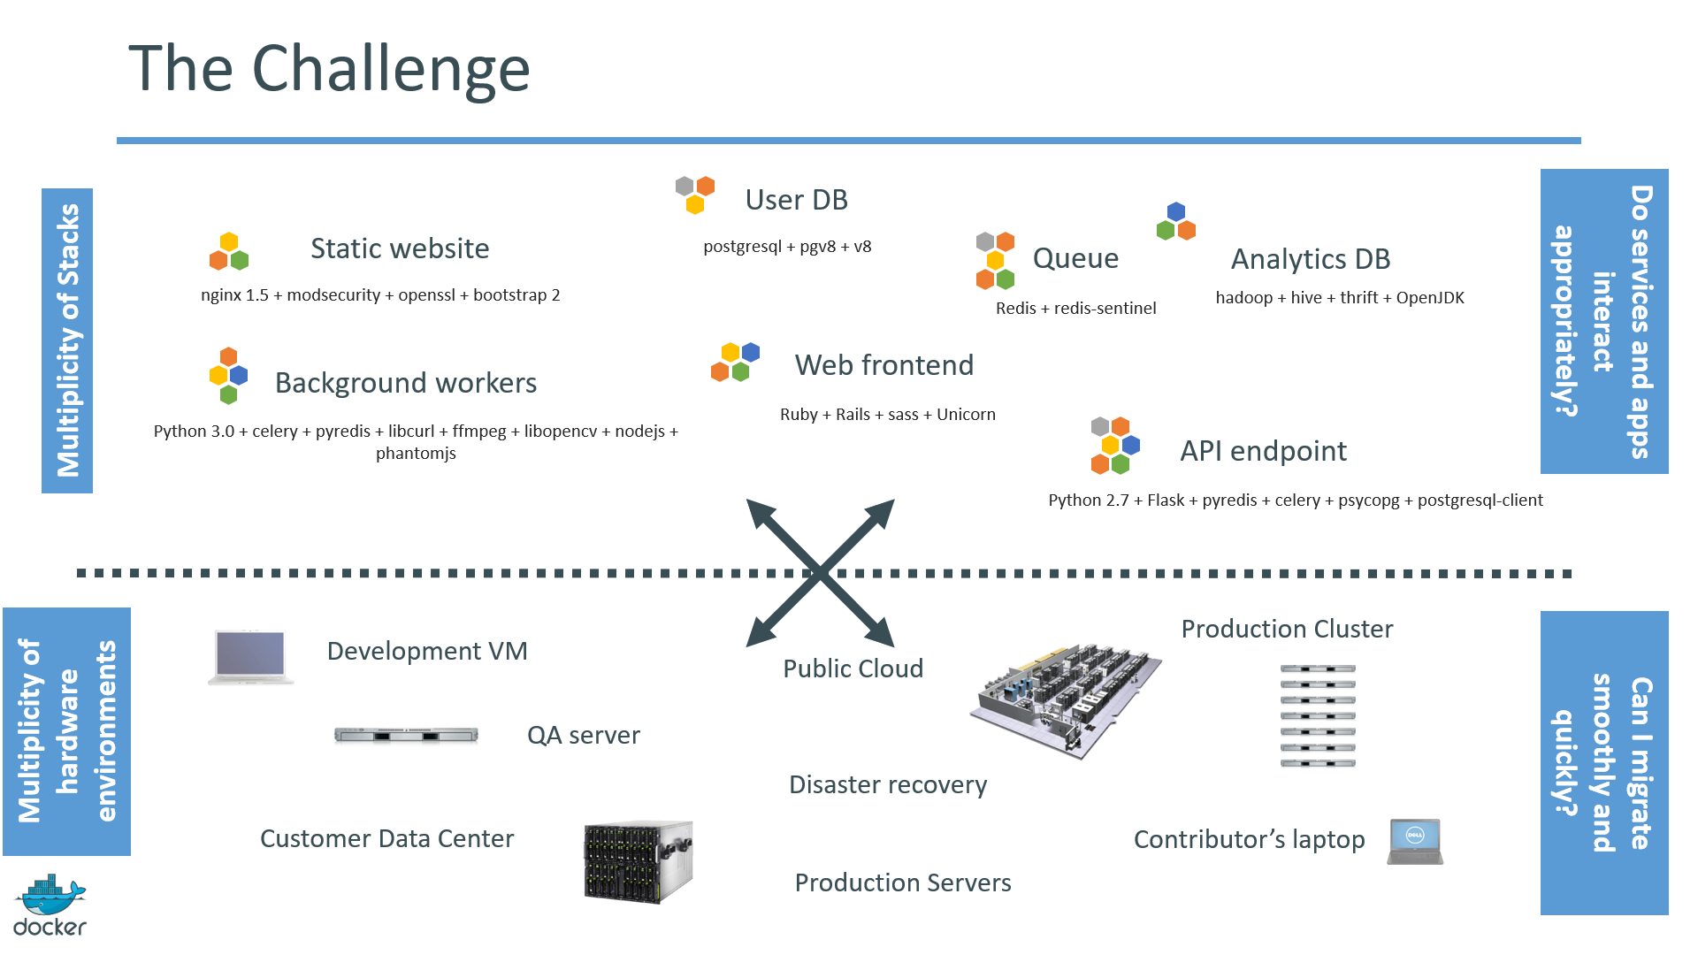
Docker Official Introduction in 2013 … Continued

Slide 9
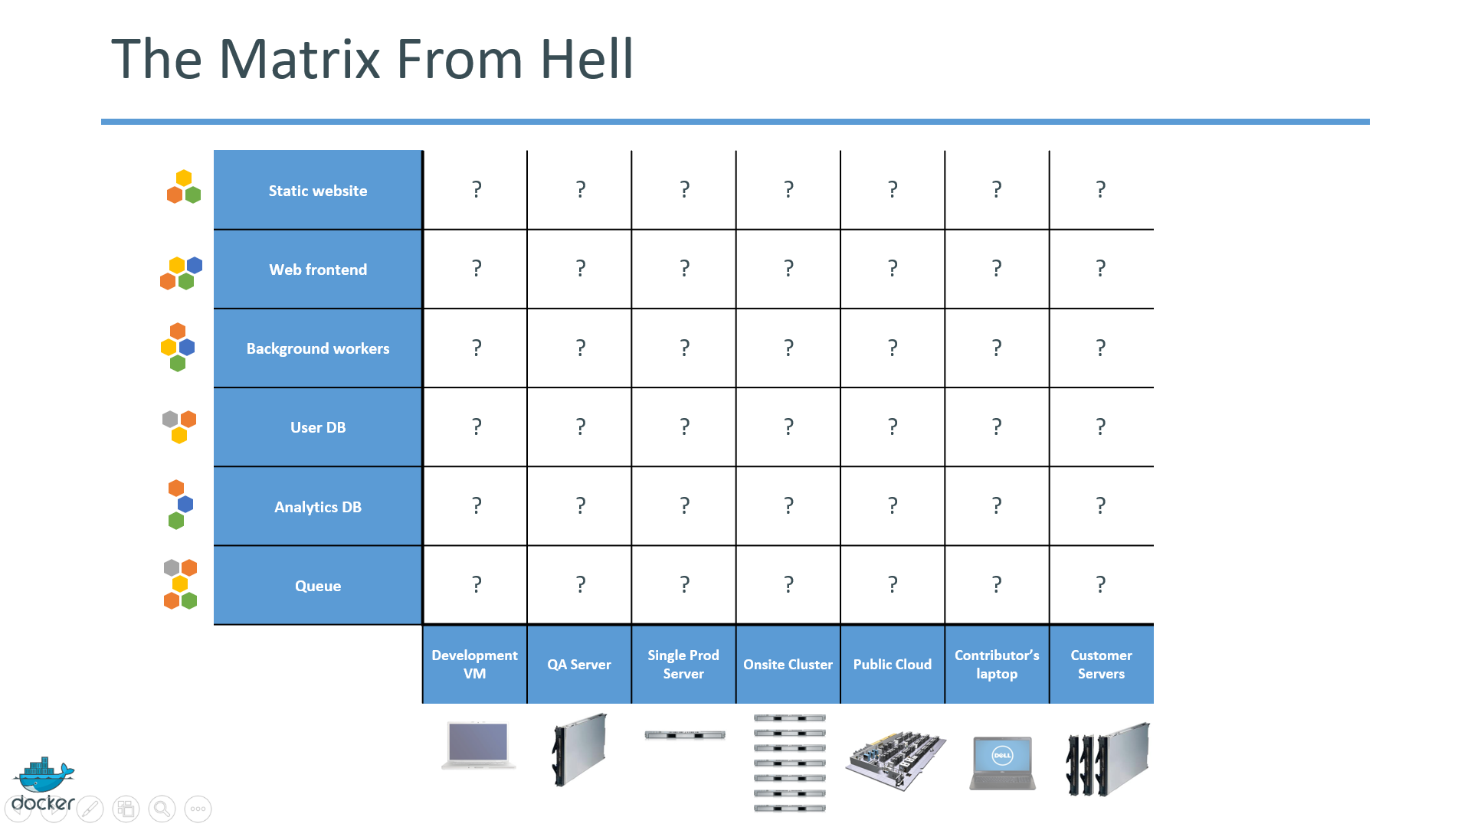
Docker Official Introduction in 2013 … Continued

Slide 10
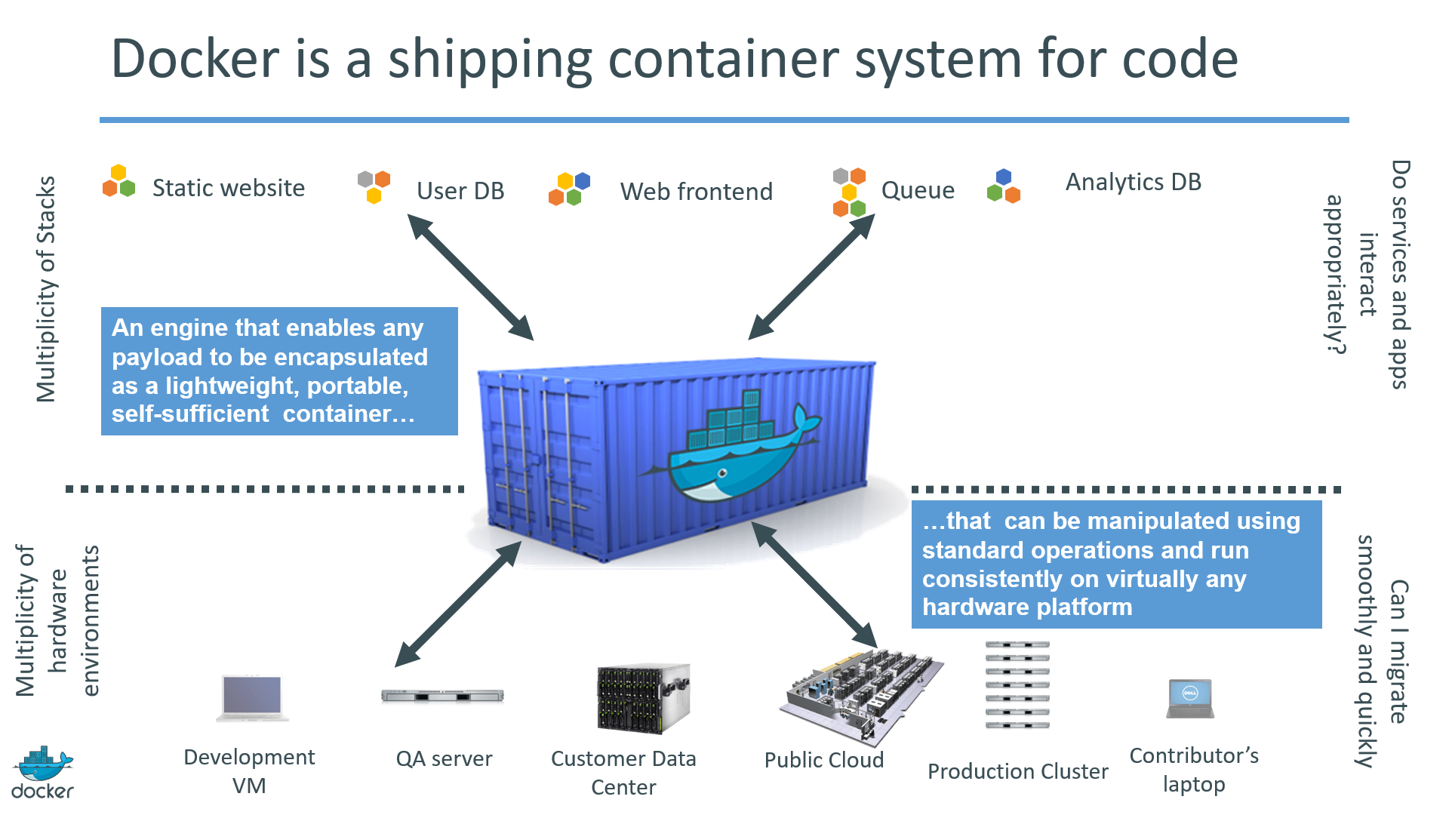
Docker Official Introduction in 2013 … Continued

Slide 11
Why Developers ?
Build once…run anywhere
A clean, safe, hygienic and portable runtime environment for your app.
No worries about missing dependencies, packages etc during deployments.
Run each app in its own isolated container,
Run various versions of libraries and other dependencies for each app

Slide 12
Why Developers ?
Build once…run anywhere
Automate testing, integration, packaging…anything you can script
Reduce/eliminate concerns about compatibility on different platforms.
Cheap, zero-penalty containers to deploy services.
A VM without the overhead of a VM.
Instant replay and reset of image snapshots

Slide 13
Why Ops ?
Configure once…run anything
Make the entire lifecycle more efficient, consistent, and repeatable
Increase the quality of code produced by developers.
Eliminate inconsistencies between development, test, production, and customer environments

Slide 14
Why Ops ?
Configure once…run anything
Support segregation of duties
Significantly improves the speed and reliability of CI/CD systems
Because the containers are so lightweight, address significant performance, costs, deployment, and portability issues normally associated with VMs

Slide 15
Why DevOps ?
Dan the Developer
Worries about what’s “inside” the container
His code
His Libraries
His Package Manager
His Apps
His Data
All Linux servers look the same
Oscar the Ops Guy
Worries about what’s “outside” the container
Logging
Remote access
Monitoring
Network config
All containers start, stop, copy, attach, migrate, etc. the same way

Slide 16
How ?

Slide 17
Virtualization

Slide 18
Virtualization
Virtualization refers to the creation of a virtual resource such as a server, desktop, operating system, file, storage or network.
Technique of importing a Guest operating system on top of a Host operating system.
It allows developers to run multiple operating systems in different virtual machines all running on the same host.

Slide 19
Virtualization
Advantages
Multiple OS in the same machine
Easy maintenance and recovery
Lower cost of ownership
Disadvantages
Unstable performance
Hypervisors are not as efficient as host OS
Long boot-up process

Slide 20
Containers

Slide 21
Containerization
Containerization is the technique of bringing virtualization to the operating system level.
Containerization is more efficient because there is no guest OS here
It utilizes, as and when needed:
Host’s operating system,
Share relevant libraries
.. and other resources

Slide 22
Containers
A container an entirely isolated set of packages, libraries and/or applications that are completely independent from its surroundings.
In the simplest example, you place your leftovers in a plastic container and then set it on the table. Although the table lends the platform on which the leftovers are resting upon, they are independent of the table itself. What you do to one does not necessarily affect the other (although in certain instances it can).

Slide 23
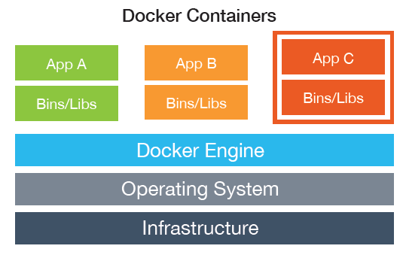
Containers

Slide 24
Virtual Machine vs Containers
App
A
App
A’
App
B
VM
Bins/
Libs
Bins/
Libs
Bins/
Libs
Guest
OS
Guest
OS
Guest
OS
Guest
OS
Guest
OS
App A
App A’
App B
App B’
App B’
App B’
Container
Docker
Bins/Libs
Bins/Libs
Host OS
Hypervisor (Type 2)
Host OS
Server
Server

Slide 25
Virtual Machine vs Containers
App
A
App
A’
App
A
App
A
App
A
Bin/
Libs
App Δ
Bins/
Libs
Bins/
Libs
Bins/
Libs
Bins/
Libs
Guest
OS
Guest
OS
Guest
OS
Guest
OS
Copy of App
No GOS. Can
Share bins/libs
Modified App
Copy on write capabilities allow
us to only save the diffs Between container A and container A’
Original App
(No GOS to take
up space, resources,
or require restart)
Every app, every copy of an app, and every slight modification of the app requires a new virtual server

Slide 26
Containerization
Advantages of Containerization
Containers on the same OS kernel are lighter and smaller
Better resource utilization compared to VMs
Boot-up process is short and takes few seconds

Slide 27
Docker

Slide 28
Docker
Open source software platform to create, deploy and manage virtualized application containers on a common OS, with an ecosystem of allied tools.
Offers the ability to :
Isolate your Applications,
Standardize your build and deployment process and
Create standard, repeatable processes.

Slide 29
Docker
.
The whole idea of Docker is for developers to easily develop applications, ship them into containers which can then be deployed anywhere.

Slide 30
Docker Containers
Wraps up a piece of software in a complete file system that contains everything it needs to run: code, runtime, system tools, system libraries ( anything you can install on a server).
By encapsulating and isolating everything in a container, this guarantees that the container will always run the same, regardless of the environment it is running in.

Slide 31
Features of Docker
Reduce the size of development by providing a
Smaller footprint of the OS via containers.
Easier for teams across different units, to work seamlessly across applications.
You can deploy Docker containers anywhere, on any physical and virtual machines and even on the cloud.
Easily scalable.

Slide 32
When to use Docker
Configuration Simplification
Enhance Developer Productivity
Server Consolidation and Management
Application Isolation
Rapid Deployment
Build Management

Slide 33
Docker ecosystem

Slide 34
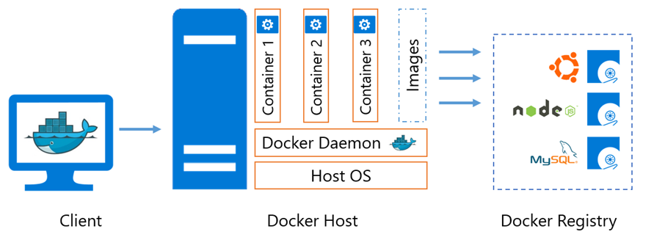
Docker Components

Slide 35
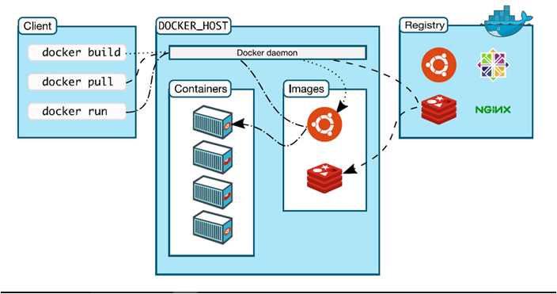
Docker Architecture

Slide 36
Docker Terminology
Docker Daemon
Runs on Host machine,
Creates and manages docker objects such as
Images,
Containers,
Network,
Volume,
Data etc
Docker Client
User Interface for docker which accepts commands from user and communicates with docker host

Slide 37
Docker Terminology
Docker Images
Used to create docker containers, provides way to build new images or update existing images
Build component of docker
Docker Containers
Created from docker images
Hold everything that is needed for an application to run
Isolated and secure application platform
Run component of docker

Slide 38
LAB

Slide 39
Docker Terminology
Dockerfile
Starting point of the dockerization process.
Details the configuration of an application and specifies resources needed
Tells the image builder (eg. Jenkins) what the image should look like.
Docker Registries
Public or private stores from which you upload/download images
Can be done on docker hub which is docker’s version of github
Distribution component of docker

Slide 40
Docker Terminology
Docker Engine
The container runtime with built in orchestration, networking and security that installs on any physical, virtual (VM) or cloud host (AWS, Azure, Google Cloud Enterprise etc).
The lightweight runtime installs directly on the host OS i.e Windows Server 2016, Ubuntu, CentOS, RHEL OpenSUSE.

Slide 41
Docker Terminology …
Containers are built from a Docker image.
The Docker image uses union filesystems and is comprised of multiple layers.
“docker run” command spins up a container from the defined image
Commands include creating new containers, scaling existing containers, stopping, removing etc.

Slide 42
What Applications to Containerize
Stateless
no need to take into account persistent data such as with databases or a shared file system.
Examples
Web servers with static resources - Apache, Nginx, IIS
Application servers - Tomcat, nodeJS , JBoss, Symphony, .NET
Microservices - Spring Boot, Play
Tools - Maven, Gradle, scripts, tests

Slide 43
What Applications to Containerize
Stateful
state of the component must be stored or synchronized with other instances
Examples
Application servers with stateful applications
Databases — Databases usually need to persist data on a filesystem.
Documents such as PDFs, pictures, Word files, etc.

Slide 44
What Applications to Containerize
Complex Product Installation
Installation with external dependencies
Installation that requires fixed IP address
Non-scriptable installation
Non-idempotent installation process .

Slide 45
THANK YOU
Let us know how can we help your organization to Upskill the employees to stay updated in the ever-evolving IT Industry.
Get in touch:
www.zekeLabs.com | +91-8095465880 | info@zekeLabs.com
Visit : www.zekeLabs.com for more details

